Slide 1
Object Oriented Programming Lecture - 36
Prof. Varsha Dange

Slide 2
File Handling
Modern version of Java define two types of streams: byte and character to perform operations on file----
Byte Stream: provide convenient means for handling input and output of bytes
Character Stream: designed for handling input and output of characters
Read operation
Write operation

Slide 3
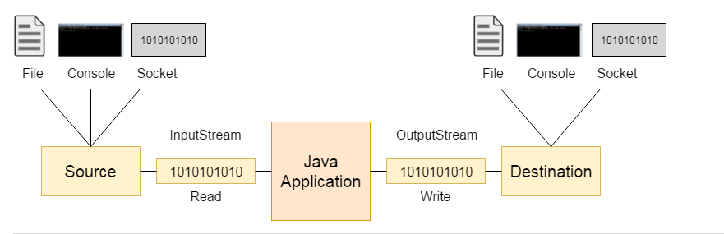
Input and Output Stream

Slide 4
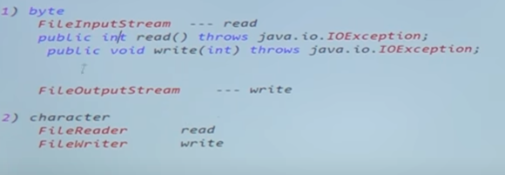
File Handling
FileInputSream ----(read)
Byte Stream
FileOutputSream ----(write)
FileReader ----(read)
CharStream
FileWriter ----(write)
Abc.txt is mandatory but xyz.txt is not
Abc.txt
FIS
java
read
FOS
xyz.txt
write

Slide 5
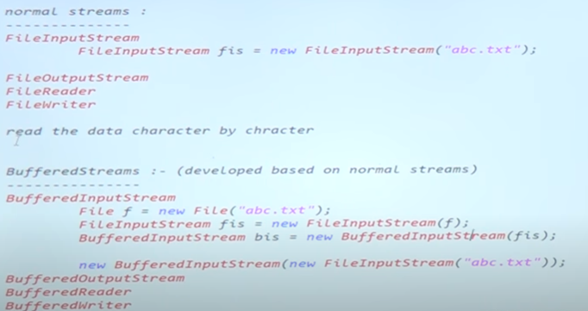


File Handling

Slide 6
FileReader class
Method | Purpose
int read() | It is used to read character data using read stream and indicate EOF with -1
Void close() | It is used to close the FileReader stream
FileReader(File file)
Pass File class object to constructor
FileReader(String Filename)
Pass file name to constructor

Slide 7
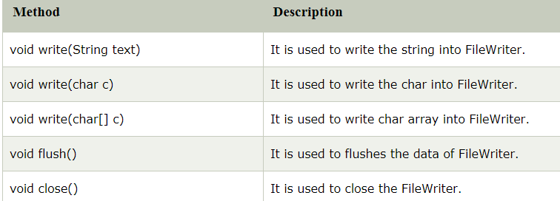
Methods of FileWriter class

Slide 8
File Handling
Files are useful for storing the persistent and shared information.
Various commonly used operations using File class are –
1) File creation.
2) reading a file
3) Closing a file.
4) Getting name of file.
5) delete a file.
6) Checking whether the file is writable.
7) Checking whether the file is readable.

Slide 9
File Constructor and Methods
The file constructor is used in Java while handling the file I/O.
File f1=new File("input.txt");

Slide 10
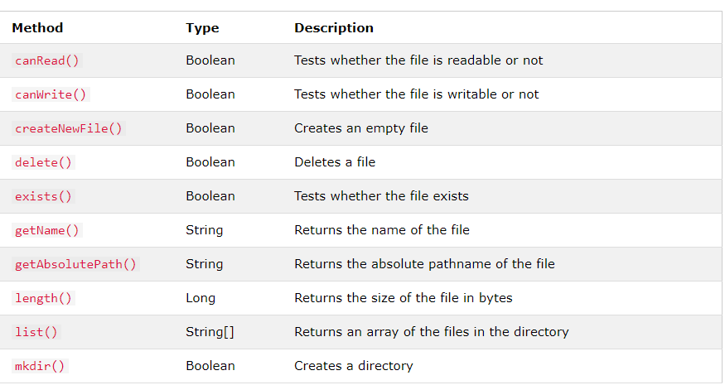
File Methods

Slide 11
Object data processing
Serialization in the process of converting java object in network supported file format
Writing java object in text file (writeObject())
Classes are required –FileOutputStream,ObjectOutputStream
Process of reading the object from network supported file format is called deserialization (readObject())
Classes are required –FileInputStream,ObjectInputStream

Slide 12
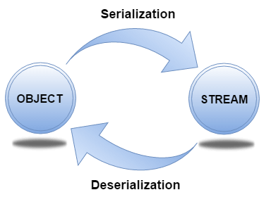
Object data processing
Serialization and Deserialization in Java:
Serialization in Java is mainly used in Hibernate, RMI, JPA, EJB and JMS technologies.
The Serializable interface must be implemented by the class whose object needs to be persisted.
The String class and all the wrapper classes implement the java.io.Serializable interface by default.
If you don't want to serialize any data member of a class, you can mark it as transient.

Slide 13
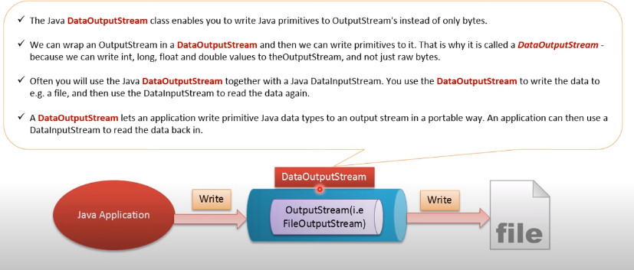
Primitive data processing

Slide 14
Primitive data processing
Method | Description
int size() | It is used to return the number of bytes written to the data output stream.
void write(int b) | It is used to write the specified byte to the underlying output stream.
void writeBoolean(boolean v) | It is used to write Boolean to the output stream as a 1-byte value.
void writeChar(int v) | It is used to write char to the output stream as a 2-byte value.
void writeByte(int v) | It is used to write a byte to the output stream as a 1-byte value.
void writeInt(int v) | It is used to write an int to the output stream
void writeShort(int v) | It is used to write a short to the output stream.
void writeLong(long v) | It is used to write a long to the output stream.
void writeUTF(String str) | It is used to write a string to the output stream using UTF-8 encoding in portable manner.
void flush() | It is used to flushes the data output stream.

